Slide 1
Search Engines
Information Retrieval in Practice
All slides ©Addison Wesley, 2008

Slide 2
Evaluation
Evaluation is key to building effective and efficient search engines
measurement usually carried out in controlled laboratory experiments
online testing can also be done
Effectiveness, efficiency and cost are related
e.g., if we want a particular level of effectiveness and efficiency, this will determine the cost of the system configuration
efficiency and cost targets may impact effectiveness

Slide 3
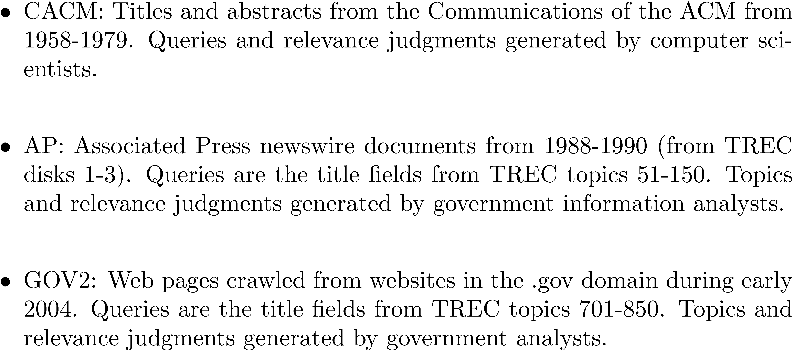
Evaluation Corpus
Test collections consisting of documents, queries, and relevance judgments, e.g.,

Slide 4
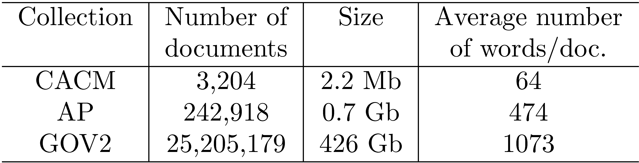
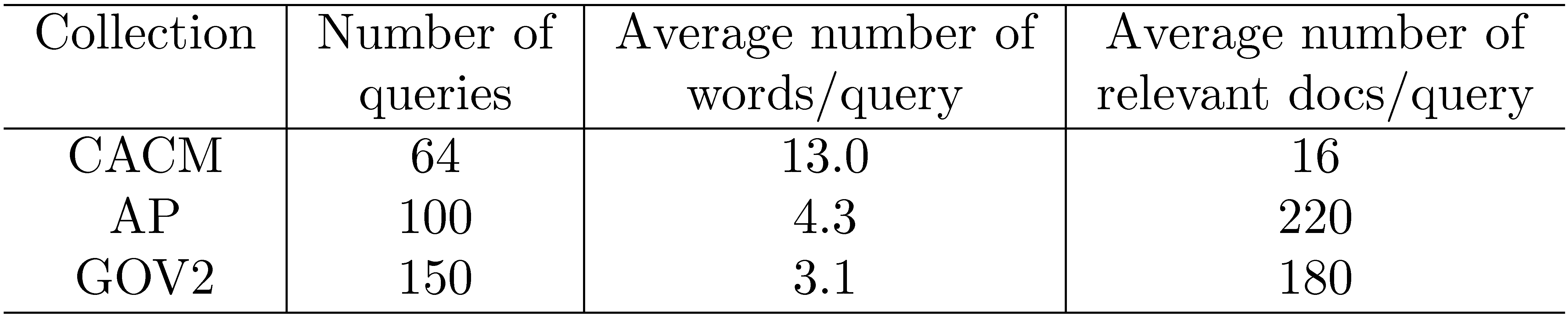
Test Collections
Sample of document under .GOV http://ir.dcs.gla.ac.uk/test_collections/samples/GOV_sampleDoc
Sample under wt10g http://ir.dcs.gla.ac.uk/test_collections/samples/wt2g_sampleDoc

Slide 5
TREC Topic Example

Slide 6
Relevance Judgments
Obtaining relevance judgments is an expensive, time-consuming process
who does it?
what are the instructions?
what is the level of agreement?
TREC judgments
depend on task being evaluated
generally binary
agreement good because of “narrative”

Slide 7
Pooling
Exhaustive judgments for all documents in a collection is not practical
Pooling technique is used in TREC
top k results (for TREC, k varied between 50 and 200) from the rankings obtained by different search engines (or retrieval algorithms) [runs] are merged into a pool
duplicates are removed
documents are presented in some random order to the relevance judges
Produces a large number of relevance judgments for each query, although still incomplete

Slide 8
Query Logs
Used for both tuning and evaluating search engines
also for various techniques such as query suggestion
Typical contents
User identifier or user session identifier
Query terms - stored exactly as user entered
List of URLs of results, their ranks on the result list, and whether they were clicked on
Timestamp(s) - records the time of user events such as query submission, clicks

Slide 9
Query Logs
Clicks are not relevance judgments
although they are correlated
biased by a number of factors such as rank on result list
Can use clickthough data to predict preferences between pairs of documents
appropriate for tasks with multiple levels of relevance, focused on user relevance
various “policies” used to generate preferences

Slide 10
Query Logs
Click data can also be aggregated to remove noise
Click distribution information
can be used to identify clicks that have a higher frequency than would be expected
high correlation with relevance

Slide 11
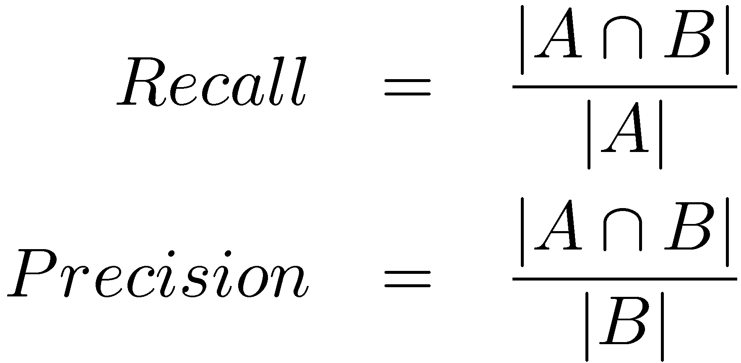
Effectiveness Measures
A is set of relevant documents,
B is set of retrieved documents

Slide 12
Ranking Effectiveness
1 over 6
1 over 1

Slide 13
Summarizing a Ranking
Calculating recall and precision at fixed rank positions
Calculating precision at standard recall levels, from 0.0 to 1.0
requires interpolation
Averaging the precision values from the rank positions where a relevant document was retrieved

Slide 14
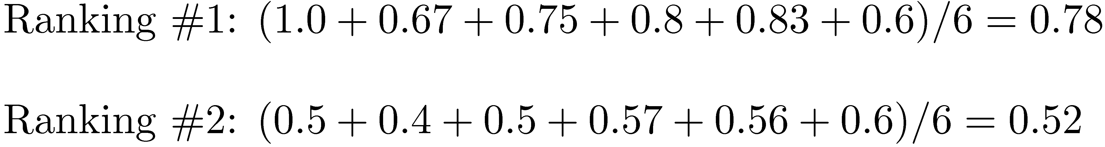
Average Precision

Slide 15
Averaging Across Queries

Slide 16
Averaging
Mean Average Precision (MAP)
summarize rankings from multiple queries by averaging average precision
most commonly used measure in research papers
assumes user is interested in finding many relevant documents for each query
requires many relevance judgments in text collection
Recall-precision graphs are also useful summaries

Slide 17
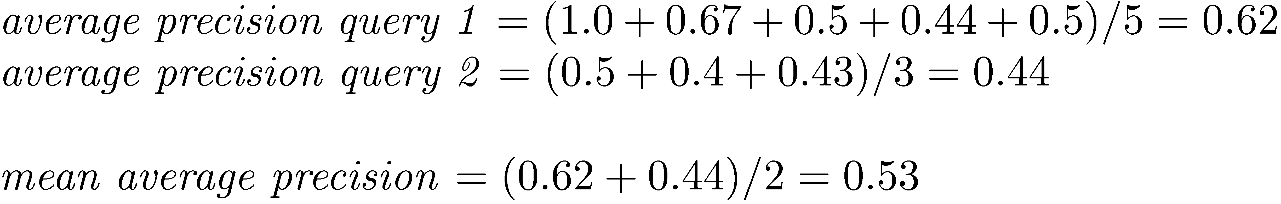
MAP

Slide 18
Focusing on Top Documents
Users tend to look at only the top part of the ranked result list to find relevant documents
Some search tasks have only one relevant document
e.g., navigational search, question answering
Recall not appropriate
instead need to measure how well the search engine does at retrieving relevant documents at very high ranks

Slide 19
Focusing on Top Documents
Precision at Rank R (precision@R)
R typically 5, 10, 20
easy to compute, average, understand
not sensitive to rank positions less than R
Reciprocal Rank
reciprocal of the rank at which the first relevant document is retrieved
Mean Reciprocal Rank (MRR) is the average of the reciprocal ranks over a set of queries
very sensitive to rank position

Slide 20
Discounted Cumulative Gain
Popular measure for evaluating web search and related tasks
Two assumptions:
Highly relevant documents are more useful than marginally relevant document
the lower the ranked position of a relevant document, the less useful it is for the user, since it is less likely to be examined

Slide 21
Discounted Cumulative Gain
Uses graded relevance as a measure of the usefulness, or gain, from examining a document
Gain is accumulated starting at the top of the ranking and may be reduced, or discounted, at lower ranks
Typical discount is 1/log (rank)
With base 2, the discount at rank 4 is 1/2, and at rank 8 it is 1/3

Slide 22
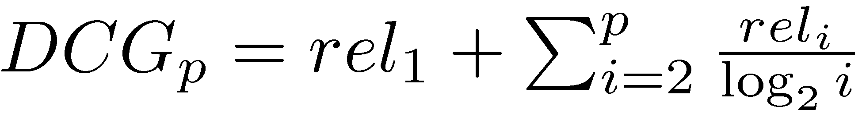

Discounted Cumulative Gain
DCG is the total gain accumulated at a particular rank p:
Alternative formulation:
used by some web search companies
emphasis on retrieving highly relevant documents

Slide 23
DCG Example
10 ranked documents judged on 0-3 relevance scale:
3, 2, 3, 0, 0, 1, 2, 2, 3, 0
discounted gain:
3, 2/1, 3/1.59, 0, 0, 1/2.59, 2/2.81, 2/3, 3/3.17, 0
= 3, 2, 1.89, 0, 0, 0.39, 0.71, 0.67, 0.95, 0
DCG:
3, 5, 6.89, 6.89, 6.89, 7.28, 7.99, 8.66, 9.61, 9.61

Slide 24
Normalized DCG
DCG numbers are averaged across a set of queries at specific rank values
e.g., DCG at rank 5 is 6.89 and at rank 10 is 9.61
DCG values are often normalized by comparing the DCG at each rank with the DCG value for the perfect ranking
makes averaging easier for queries with different numbers of relevant documents

Slide 25
NDCG Example
Perfect ranking:
3, 3, 3, 2, 2, 2, 1, 0, 0, 0
ideal DCG values:
3, 6, 7.89, 8.89, 9.75, 10.52, 10.88, 10.88, 10.88, 10
NDCG values (divide actual by ideal):
1, 0.83, 0.87, 0.76, 0.71, 0.69, 0.73, 0.8, 0.88, 0.88
NDCG ≤ 1 at any rank position

Slide 26
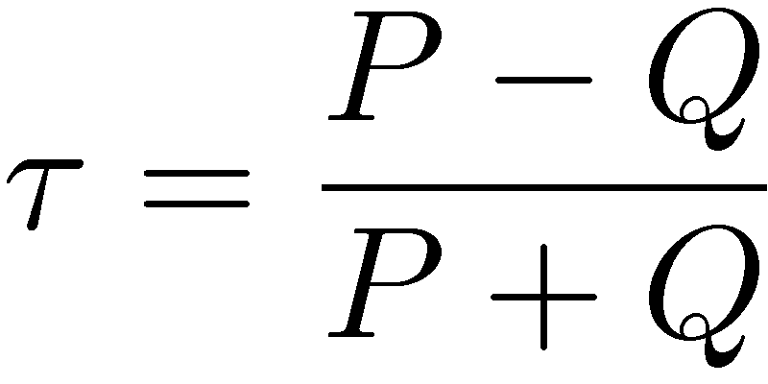
Using Preferences
Two rankings described using preferences can be compared using the Kendall tau coefficient (τ ):
P is the number of preferences that agree and Q is the number that disagree
For preferences derived from binary relevance judgments, can use BPREF

Slide 27
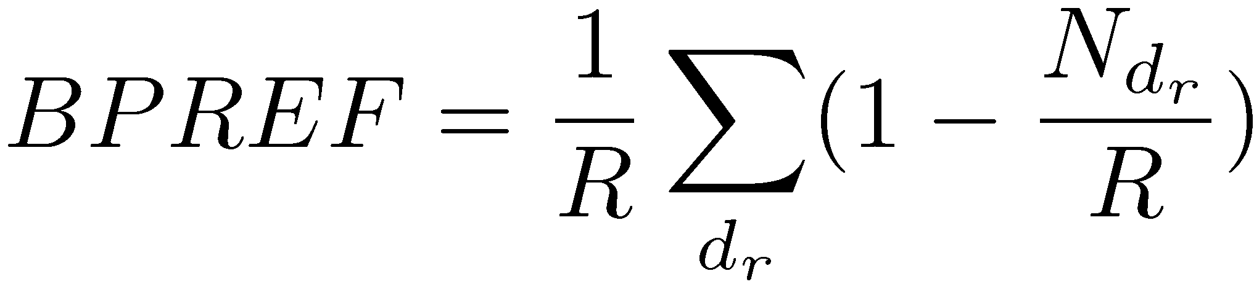
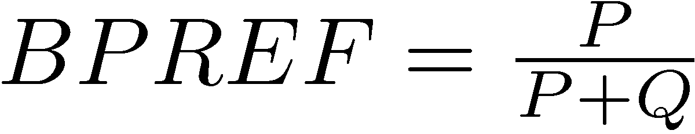
BPREF
For a query with R relevant documents, only the first R non-relevant documents are considered
d_{r} is a relevant document, and N_{dr} gives the number of non-relevant documents
Alternative definition
The bpref measure is designed for situations where relevance judgments are known to be far from complete
Bpref can be thought of as the inverse of the fraction of judged irrelevant documents that are retrieved before relevant ones.
Bpref and mean average precision are very highly correlated when used with complete judgments. But when judgments are incomplete, rankings of systems by bpref still correlate highly to the original ranking, whereas rankings of systems by MAP do not.

Slide 28
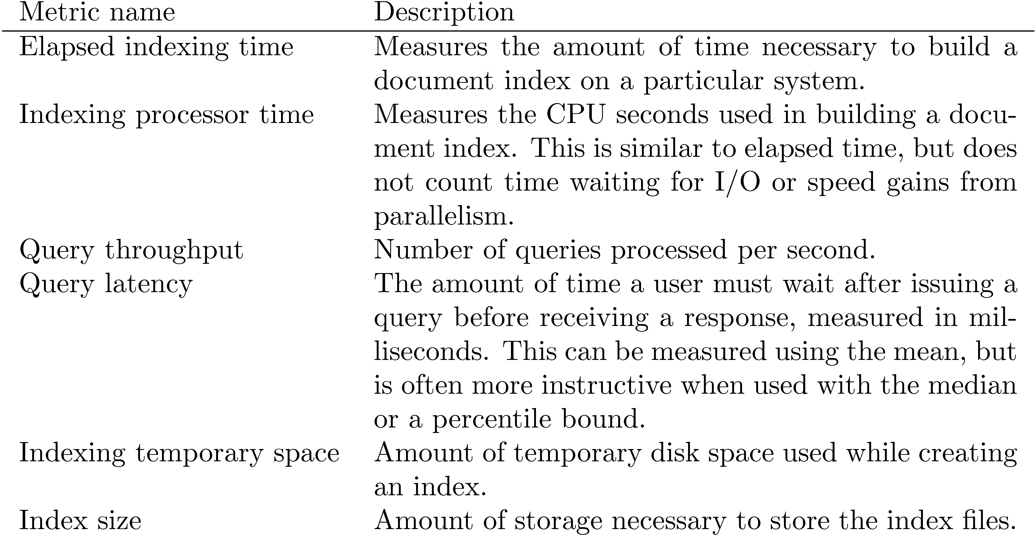
Efficiency Metrics

Slide 29
Significance Tests
Given the results from a number of queries, how can we conclude that ranking algorithm A is better than algorithm B?
A significance test enables us to reject the null hypothesis (no difference) in favor of the alternative hypothesis (B is better than A)
the power of a test is the probability that the test will reject the null hypothesis correctly
increasing the number of queries in the experiment also increases power of test

Slide 30
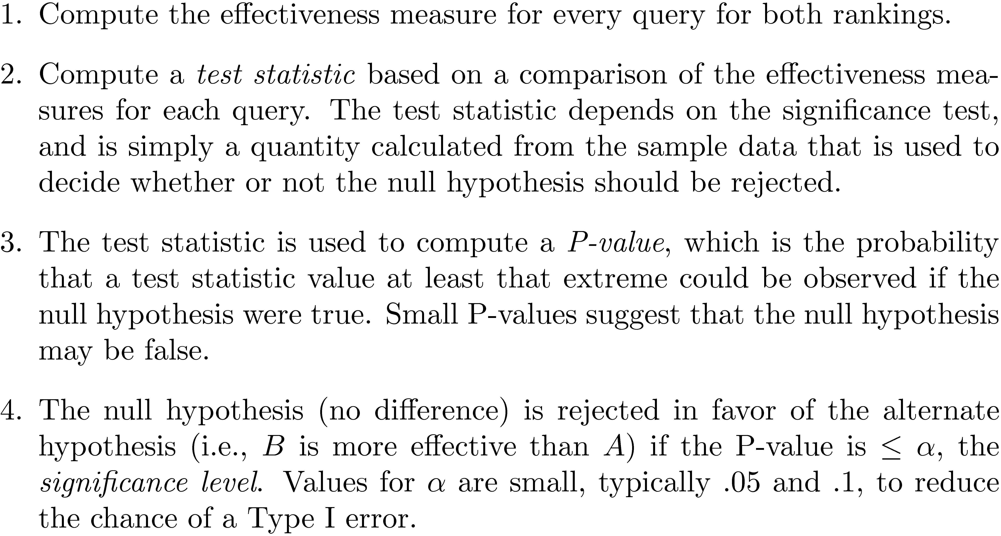
Significance Tests

Slide 31
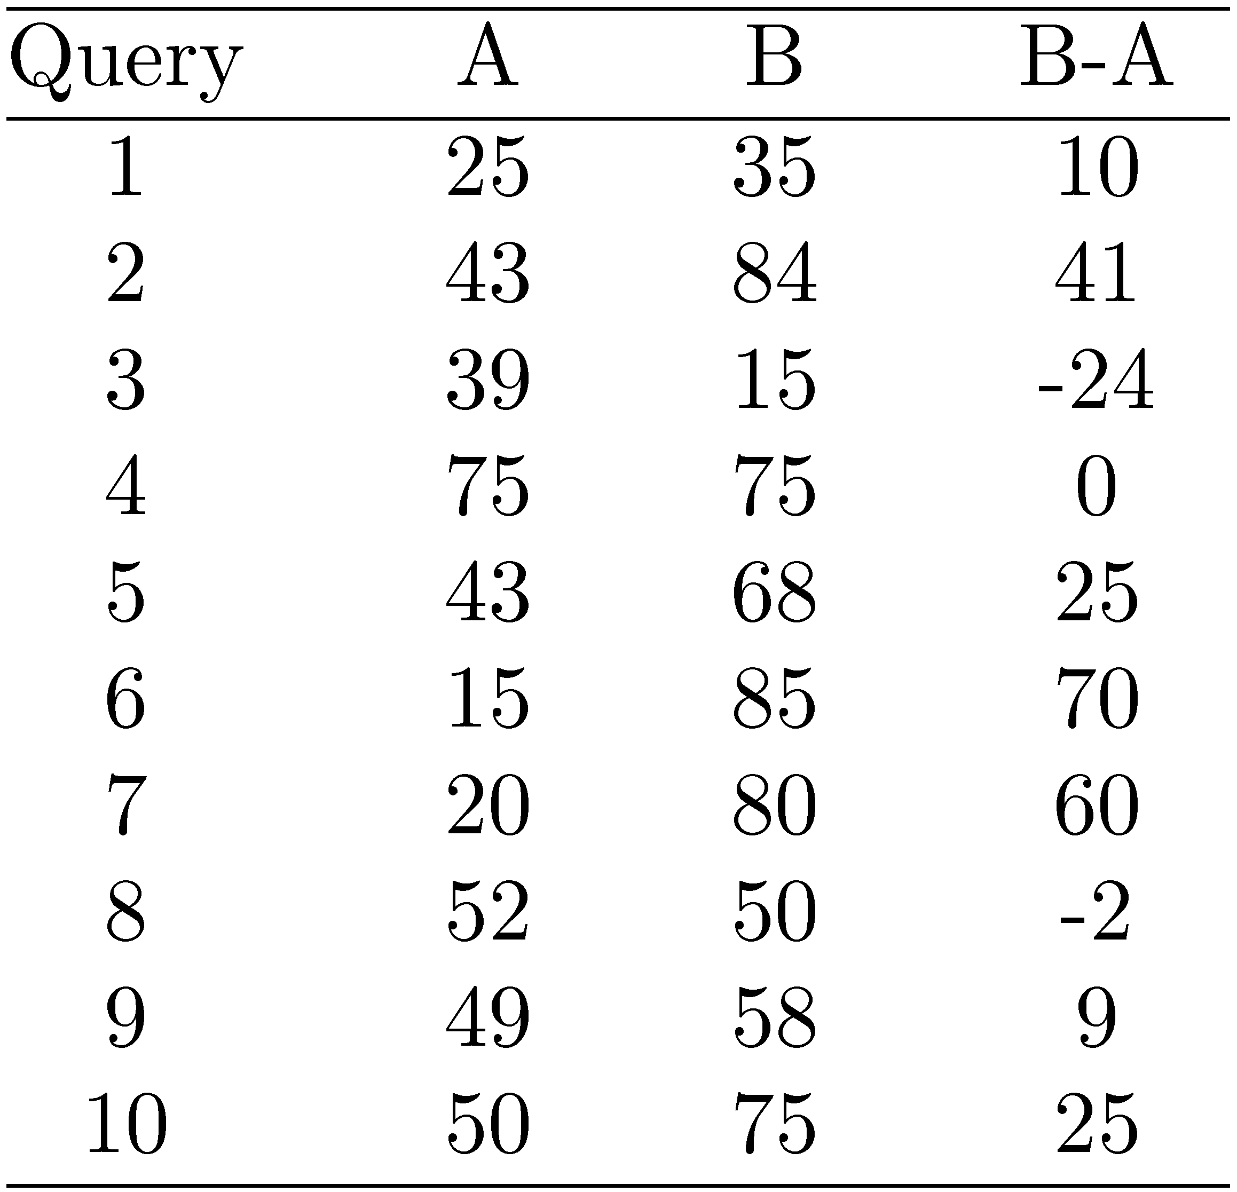
Example Experimental Results

Slide 32
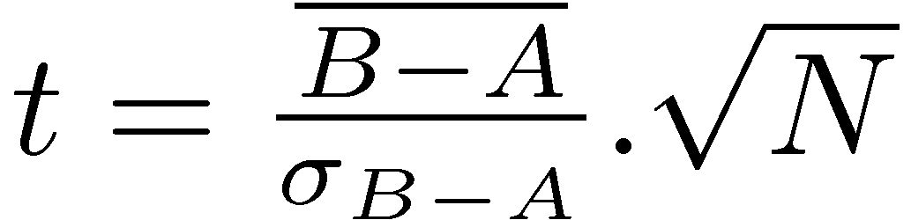
t-Test
Assumption is that the difference between the effectiveness values is a sample from a normal distribution [Parametrics tests]
Null hypothesis is that the mean of the distribution of differences is zero
Test statistic
for the example,

Slide 33
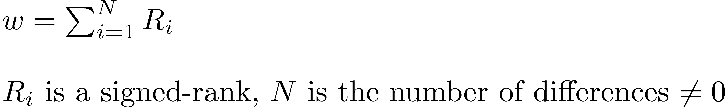
Wilcoxon Signed-Ranks Test
Nonparametric test based on differences between effectiveness scores
Test statistic
To compute the signed-ranks, the differences are ordered by their absolute values (increasing), and then assigned rank values
rank values are then given the sign of the original difference

Slide 34
Wilcoxon Example
9 non-zero differences are (in rank order of absolute value):
2, 9, 10, 24, 25, 25, 41, 60, 70
Signed-ranks:
-1, +2, +3, -4, +5.5, +5.5, +7, +8, +9
w = 35, p-value = 0.025

Slide 35
Sign Test
Ignores magnitude of differences
Null hypothesis for this test is that
P(B > A) = P(A > B) = ½
number of pairs where B is “better” than A would be the same as the number of pairs where A is “better” than B
Test statistic is number of pairs where B>A
For example data,
test statistic is 7, p-value = 0.17
cannot reject null hypothesis

Slide 36
Setting Parameter Values
Retrieval models often contain parameters that must be tuned to get best performance for specific types of data and queries
For experiments:
Use training and test data sets
If less data available, use cross-validation by partitioning the data into K subsets
Using training and test data avoids overfitting – when parameter values do not generalize well to other data

Slide 37
Summary
No single measure is the correct one for any application
choose measures appropriate for task
use a combination
shows different aspects of the system effectiveness
Use significance tests (t-test)
Analyze performance of individual queries

